Slide 1


15 September 2026
Project Phase-I Review-I
01 October 2026
Paper Title: AI Model Hallucination Detection & Response Validation Platform
Presented by:
Ms. Ayesha Siddiqua (160923753018)
Mr. Mohammad Ahraaz (160923753003)
Ms. Soha Mahreen (160923753006)
Under the Guidance of
Mr. Yellaiah Ponnam, Associate Profressor
Department of IT, Lords Institute of Engineering and Technology, (Autonomous), Hyderabad –Telangana -India

Slide 2
OUTLINES
15 September 2026
Advantages of Proposed system
Methodology
System Architecture
Techniques
Datasets
Implementation
Results
Conclusion
References
Abstract
Introduction
Problem Statement
Proposed System
Literature Survey
Existing System
Limitations of Existing Systems
Objectives
Department of IT, Lords Institute of Engineering and Technology, (Autonomous), Hyderabad –Telangana -India

Slide 3
Abstract
15 September 2026
AI systems may produce incorrect, unsupported, or unreliable outputs even when they appear convincing, making continuous monitoring essential.
This project proposes an AI Model Hallucination Detection and Response Validation Platform to evaluate AI-generated responses and identify potential hallucinations using reference evidence and quality metrics.
The platform also monitors data drift, tracks model and prompt versions, and uses reliability indicators and alerts to highlight potential changes in AI system behavior.
The proposed system aims to improve AI reliability, transparency, and traceability by maintaining evaluation records and supporting human verification of uncertain results.
Department of IT, Lords Institute of Engineering and Technology, (Autonomous), Hyderabad –Telangana -India

Slide 4
15 September 2026
Introduction
Generative AI and Large Language Models (LLMs) are increasingly used for applications such as chatbots, information retrieval, content generation, and decision support.
Despite their capabilities, AI models can produce hallucinated responses—information that is inaccurate, unsupported, or inconsistent with the available context.
Such responses can reduce trust, reliability, and safety when AI systems are used in real-world applications.
Therefore, there is a need for an automated platform that can detect potential hallucinations and validate the factual consistency and contextual grounding of AI-generated responses.
The proposed platform aims to evaluate, monitor, and measure AI response reliability using automated validation techniques and meaningful evaluation metrics.
Department of IT, Lords Institute of Engineering and Technology, (Autonomous), Hyderabad –Telangana -India

Slide 5
Problem Statement
15 September 2026
Generative AI and LLMs can produce hallucinated responses that appear convincing but may contain inaccurate, unsupported, or inconsistent information.
Existing AI applications often lack an integrated mechanism to automatically detect and validate such responses before they are presented to users.
Manual evaluation of AI-generated responses is time-consuming, subjective, and difficult to scale for large volumes of outputs.
There is a need for a platform that can automatically detect potential hallucinations, validate responses against available context or reference information, and quantify their reliability.
The proposed system aims to provide automated validation, reliability metrics, monitoring, and reporting to support the development of more trustworthy AI applications.
Department of IT, Lords Institute of Engineering and Technology, (Autonomous), Hyderabad –Telangana -India

Slide 6
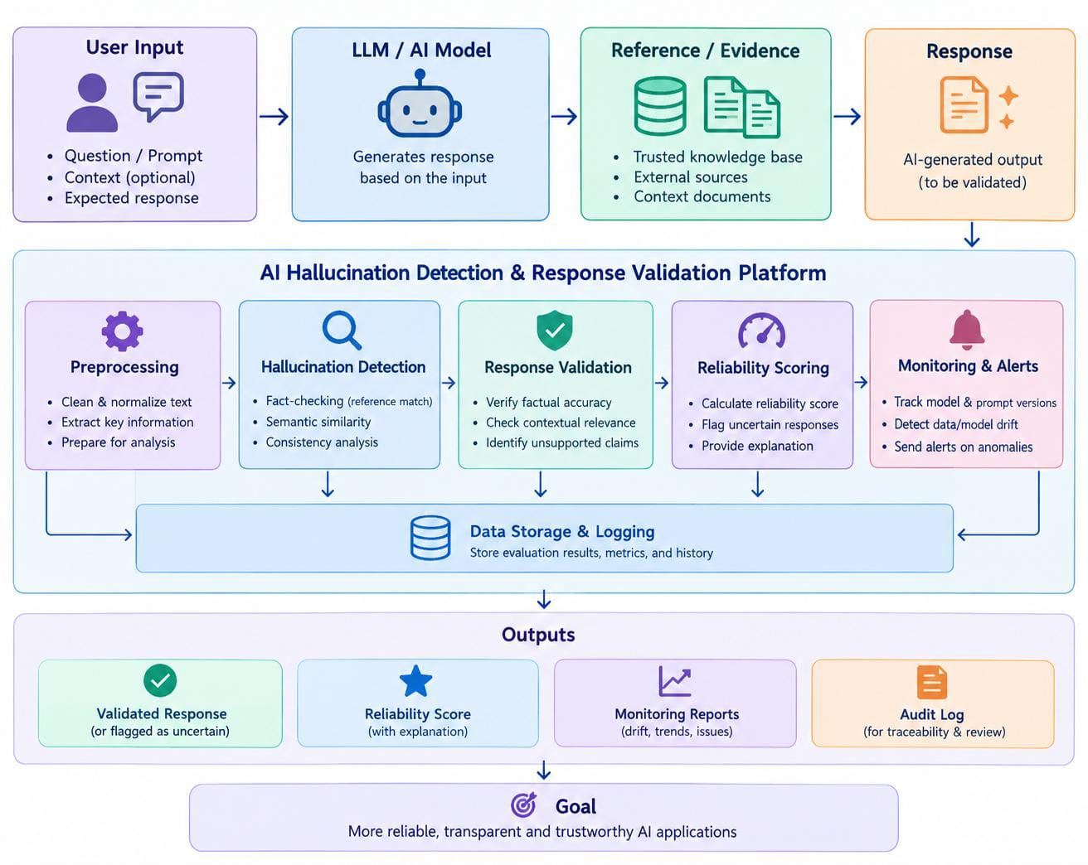
Proposed System
15 September 2026
Department of IT, Lords Institute of Engineering and Technology, (Autonomous), Hyderabad –Telangana -India

Slide 7
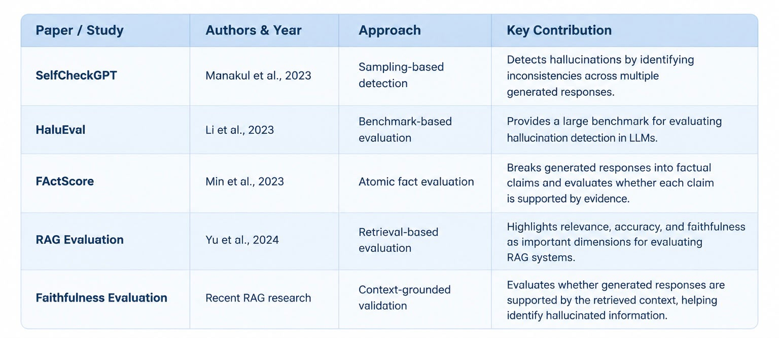
15 September 2026
Literature Survey
Department of IT, Lords Institute of Engineering and Technology, (Autonomous), Hyderabad –Telangana -India

Slide 8
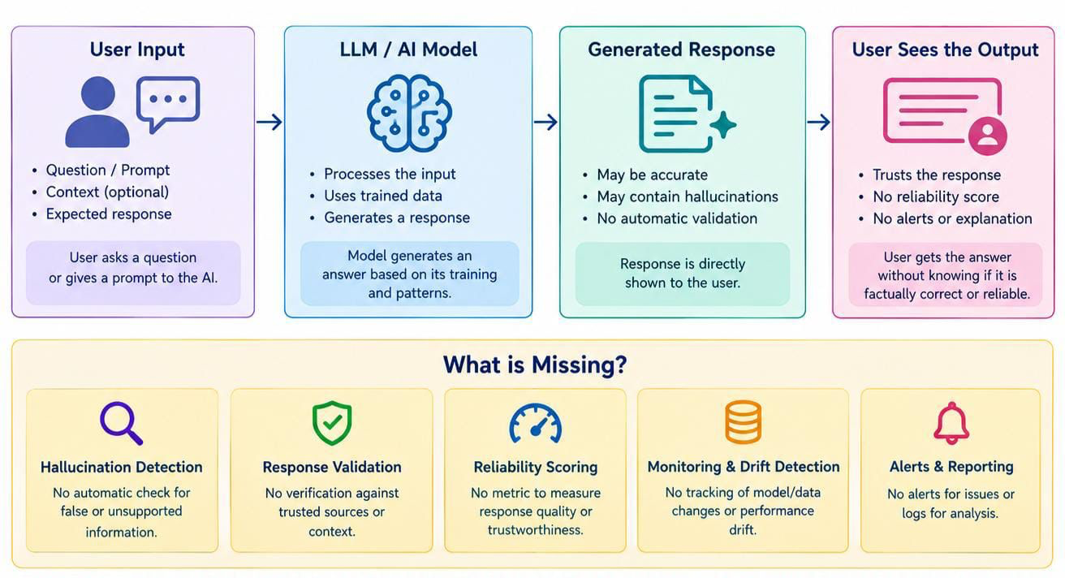
Existing Systems
15 September 2026
Department of IT, Lords Institute of Engineering and Technology, (Autonomous), Hyderabad –Telangana -India

Slide 9
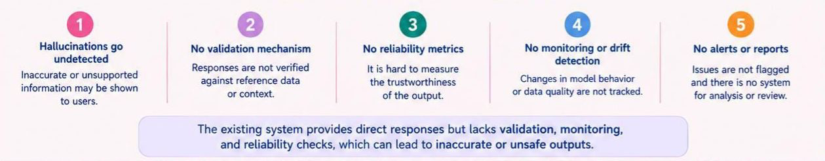
Limitations of Existing System
15 September 2026
key factors:
Department of IT, Lords Institute of Engineering and Technology, (Autonomous), Hyderabad –Telangana -India

Slide 10
Objectives
15 September 2026
1. To identify false or unsupported information generated by AI models.
2. To verify AI-generated responses using trusted references and context.
3. To measure the reliability of AI-generated responses using suitable metrics.
4. To monitor changes in data and model behaviour over time.
5. To generate alerts and maintain records of detected issues for future analysis.
Department of IT, Lords Institute of Engineering and Technology, (Autonomous), Hyderabad –Telangana -India

Slide 11
Advantages of proposed System
15 September 2026
1. Detects potential hallucinations and unsupported information in AI-generated responses.
2. Improves response reliability through evidence-based validation.
3. Monitors data drift and changes in model behaviour over time.
4. Provides alerts and reports to help identify potential issues quickly.
5. Maintains evaluation history and records for better transparency and traceability.
Department of IT, Lords Institute of Engineering and Technology, (Autonomous), Hyderabad –Telangana -India

Slide 12
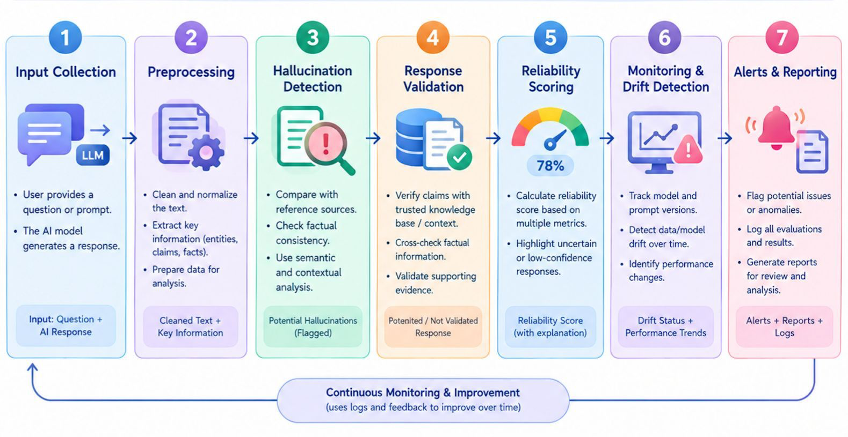
Methodology
15 September 2026
Department of IT, Lords Institute of Engineering and Technology, (Autonomous), Hyderabad –Telangana -India

Slide 13
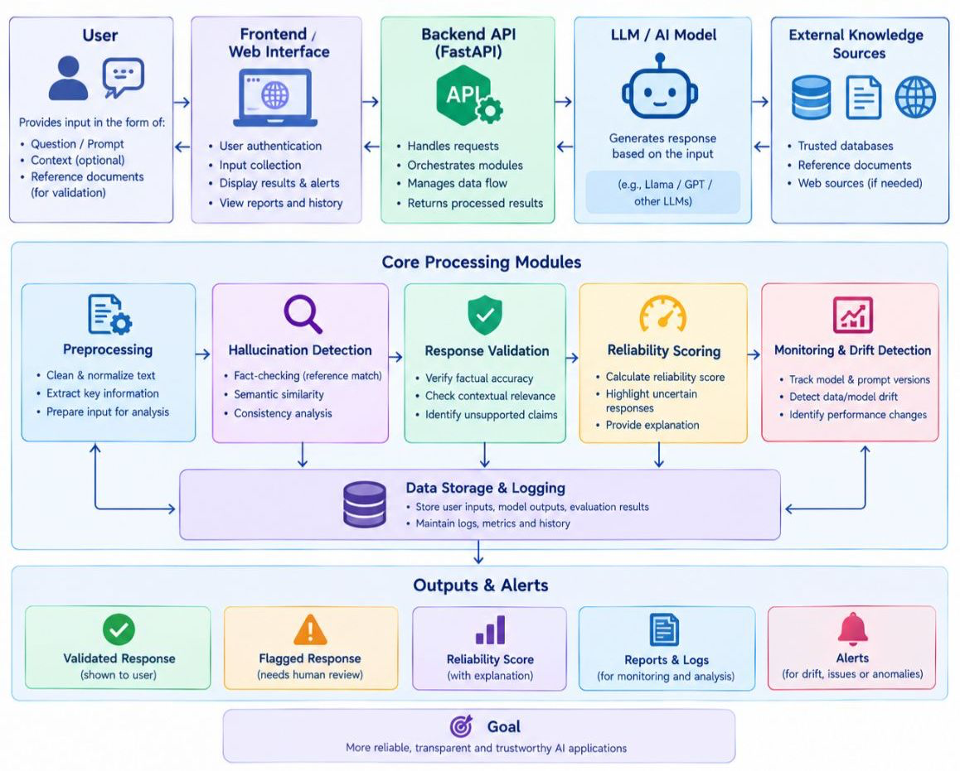
System Architecture
15 September 2026
Department of IT, Lords Institute of Engineering and Technology, (Autonomous), Hyderabad –Telangana -India

Slide 14
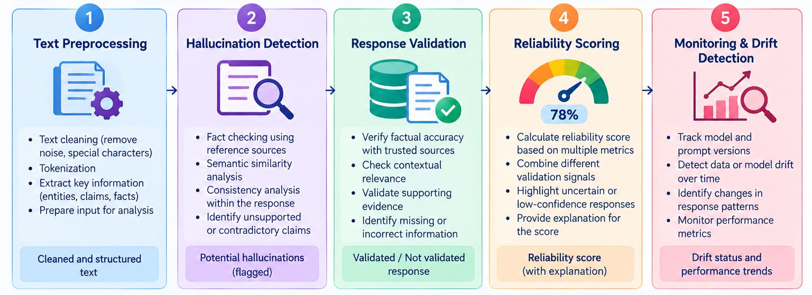
15 September 2026
Techniques
Department of IT, Lords Institute of Engineering and Technology, (Autonomous), Hyderabad –Telangana -India

Slide 15
Datasets
15 September 2026
1. We collect datasets containing AI-generated responses and trusted reference information.
2. We use publicly available datasets and relevant documents for testing and validation.
3. We clean and preprocess the data by removing unnecessary text and handling missing values.
4. We compare AI-generated responses with reference information to identify unsupported or incorrect claims.
5. We store the processed data, evaluation results, and monitoring history in a database for future analysis.
Department of IT, Lords Institute of Engineering and Technology, (Autonomous), Hyderabad –Telangana -India

Slide 16
Implementation
15 September 2026
1. Collect the user input and AI-generated responses for analysis.
2. Clean and preprocess the data to make it ready for evaluation.
3. Apply hallucination detection techniques to identify unsupported information.
4. Validate responses, calculate reliability scores, and detect possible data drift.
5. Store results in a database and display reports, alerts, and monitoring history.
Department of IT, Lords Institute of Engineering and Technology, (Autonomous), Hyderabad –Telangana -India

Slide 17
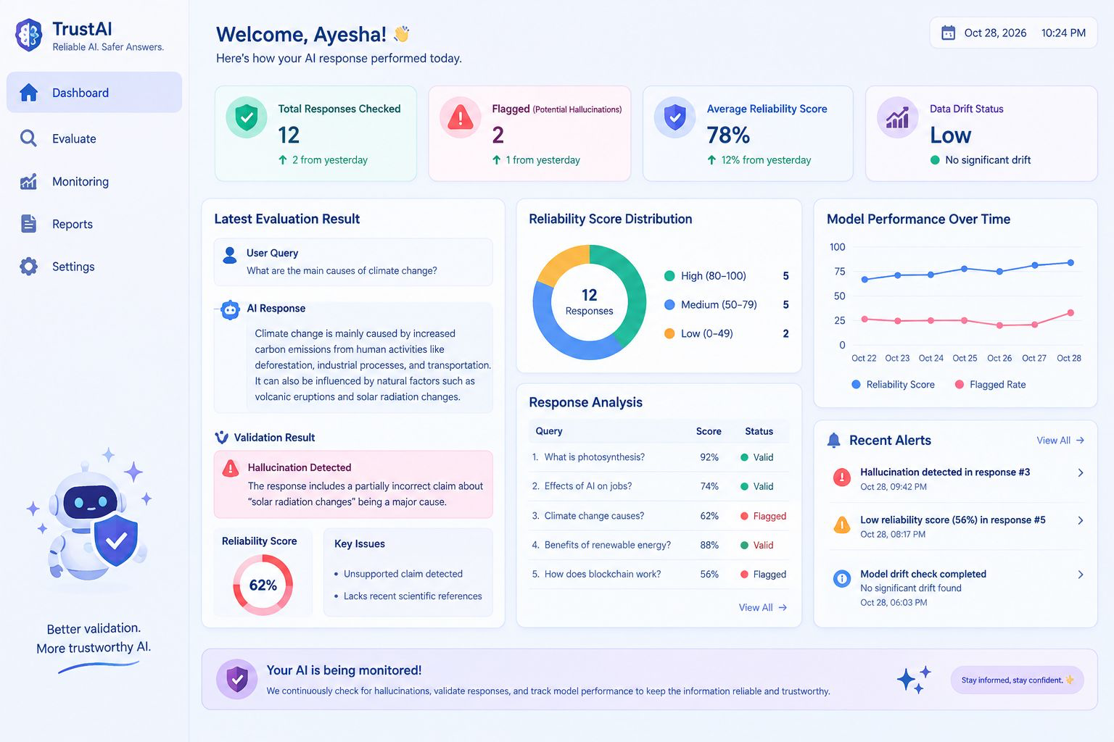
Results
15 September 2026
Department of IT, Lords Institute of Engineering and Technology, (Autonomous), Hyderabad –Telangana -India

Slide 18
Conclusion
15 September 2026
The proposed platform aims to detect and validate hallucinated AI-generated responses using contextual, semantic, and factual analysis.
It provides measurable reliability scores to evaluate the quality and trustworthiness of AI responses.
Continuous monitoring and reporting can help identify changes in response quality and potential reliability issues.
The system can provide a foundation for safer, more transparent, and dependable AI applications.
Future work can extend the platform to multiple LLMs, real-time monitoring, advanced evaluation techniques, and production-scale deployment.
Department of IT, Lords Institute of Engineering and Technology, (Autonomous), Hyderabad –Telangana -India

Slide 19
References
15 September 2026
1. P. Manakul, A. Liusie, and M. Gales, “SelfCheckGPT: Zero-Resource Black-Box Hallucination Detection for Generative Large Language Models,” Proceedings of EMNLP, 2023, pp. 9004–9017.
2. J. Li, X. Cheng, X. Zhao, J.-Y. Nie, and J.-R. Wen, “HaluEval: A Large-Scale Hallucination Evaluation Benchmark for Large Language Models,” Proceedings of EMNLP, 2023, pp. 6449–6464.
3. S. Min et al., “FActScore: Fine-grained Atomic Evaluation of Factual Precision in Long Form Text Generation,” Proceedings of EMNLP, 2023, pp. 12076–12100.
4. S. Lin, J. Hilton, and O. Evans, “TruthfulQA: Measuring How Models Mimic Human Falsehoods,” Proceedings of ACL, 2022, pp. 3214–3252.
Department of IT, Lords Institute of Engineering and Technology, (Autonomous), Hyderabad –Telangana -India

Slide 20
15 September 2026
Thank You..
Department of IT, Lords Institute of Engineering and Technology, (Autonomous), Hyderabad –Telangana -India

